Slide 1


DEVELOPMENT OF INTEGRATED WEARABLE DEVICE FOR REMOTE MONITORING OF PREGNANT WOMEN IN GHANA
Project Supervisor
Dr. Godfrey Mills
Co-Supervisor
Prof. Elsie Effah Kaufmann
Group Members
Owoh Einsteina Ofunne - 10943874
Anane George Nyarko – 10947340
Adika Nathaniel - 10957036
DATE: 2nd May 2025
UNIVERSITY OF GHANA

Slide 2

COLLABORATORS
Nathaniel Sakyi Adibuer, IT Consortium
Dr. Frank Amegah, Korle-Bu Teaching Hospital

Slide 3
TASK DELEGATION
Owoh Einsteina Ofunne - AI Model Development
George Anane Nyarko - Mobile App Development
Adika Nathaniel - Wearable Device Development

Slide 4
AI MODEL PROGRESS
KEY OBJECTIVES
Train separate models for detecting preeclampsia, and gestational diabetes.
Use real-world medical datasets to analyze health indicators.
Implement a structured machine learning pipeline from preprocessing to evaluation.
Compare different models to find the best-performing approach for each condition.

Slide 5
DATASET OVERVIEW
PREECLAMPSIA
Dataset Name: preeclampsia_dataset.csv
Source: Manually generated
Number of Samples: 10,000
Number of Input Features: 4
Output States: Low, mild or High
Description: Dataset of 10,000 records generated to predict preeclampsia risk (Low, Mild, High) based on diastolic pressure, systolic pressure, MAP and urine protein levels, with added noise to simulate real-world variability.

Slide 6
FEATURES
PREECLAMPSIA
Systolic blood pressure
Diastolic blood pressure
MAP
Protein in urine

Slide 7
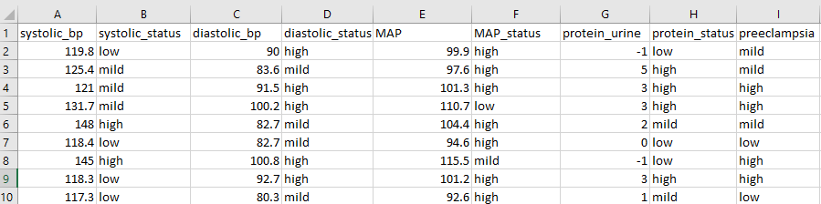
FEATURES
PREECLAMPSIA

Slide 8
THRESHOLD DESCRIPTION
PREECLAMPSIA
SOURCES:
ACOG Practice Bulletin No. 222: Gestational Hypertension and Preeclampsia
NICE_guidance_on-Pre-eclampsia_VB2020
UpToDate: Clinical features and diagnosis of preeclampsia
WHO Guidelines: WHO Recommendations for Prevention and Treatment of Preeclampsia and Eclampsia

Slide 9
DATASET OVERVIEW
GESTATIONAL DIABETES
Dataset Name: Gestational Diabetes 3.csv
Source: Manually generated
Number of Samples: 10,000
Number of Input Features: 4
Output States: Low, mild or high
Description:

Slide 10
FEATURES
GESTATIONAL DIABETES
Blood Glucose level
BMI
Family history
Body Temperature

Slide 11
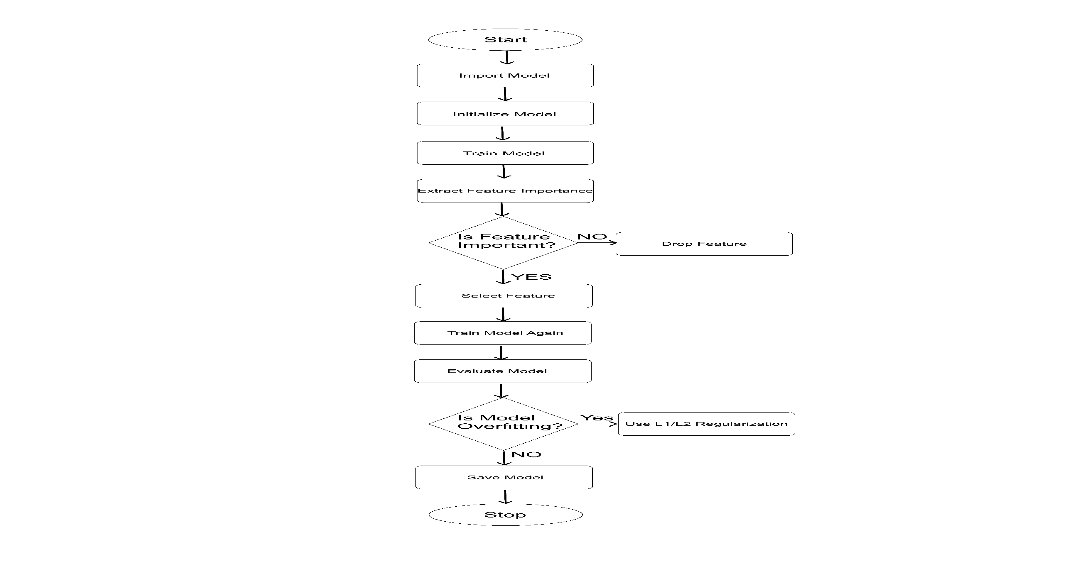
MACHINE LEARNING WORKFLOW

Slide 12
MOBILE APP PROGRESS
Setting up backend functionality for SMS Notifications for:
Medication Reminders
Antenatal Visit Reminder
Daily Pregnancy Tips Based on Subsription or Not
fhffhjhf
dhdjjdhjd
ddjdhddh
hddhdgdh
dhdjdjdh
ddjdh
djddjkd
djdkj
2) Implemention other layers of authentication and security measures using facial recognition and PINs

Slide 13
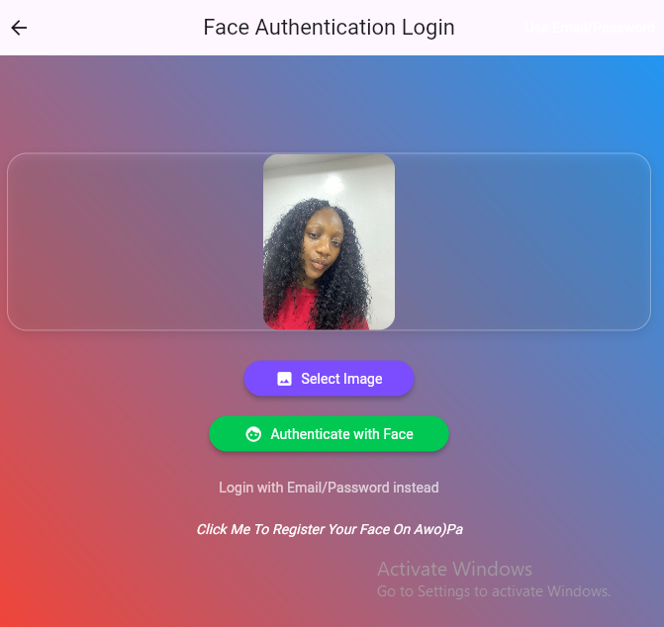
PREGNANT WOMAN

Slide 14
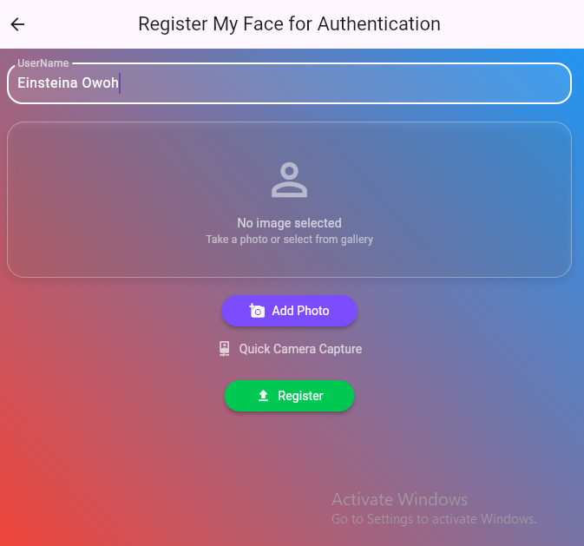
PREGNANT WOMAN

Slide 15
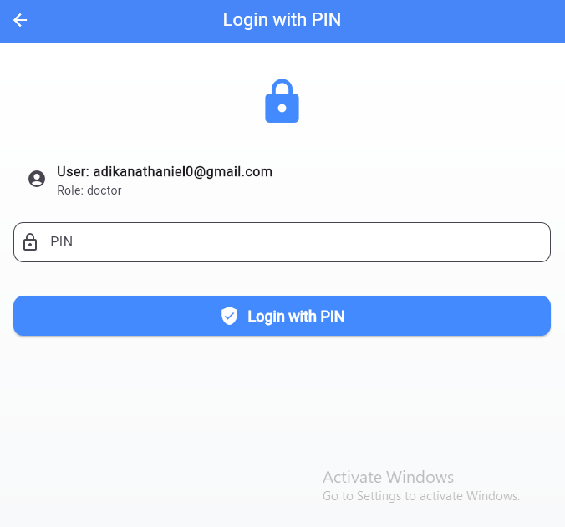
PREGNANT WOMAN

Slide 16
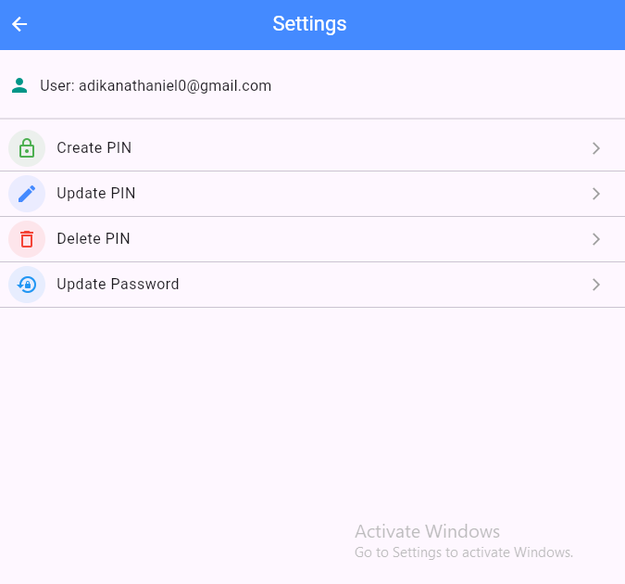
PREGNANT WOMAN

Slide 17
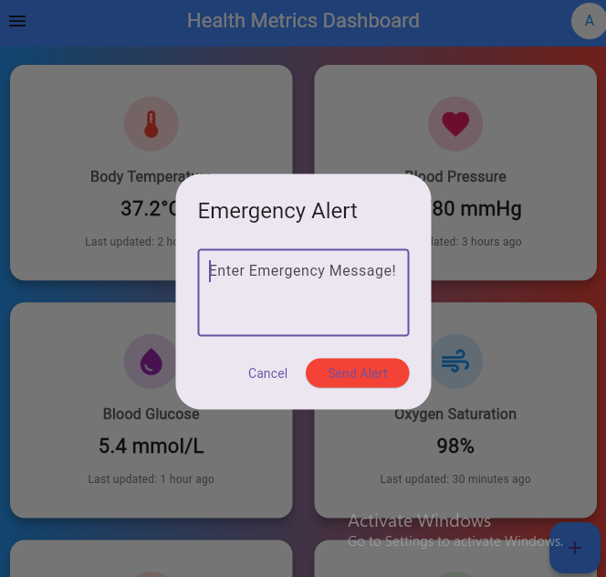
PREGNANT WOMAN

Slide 18
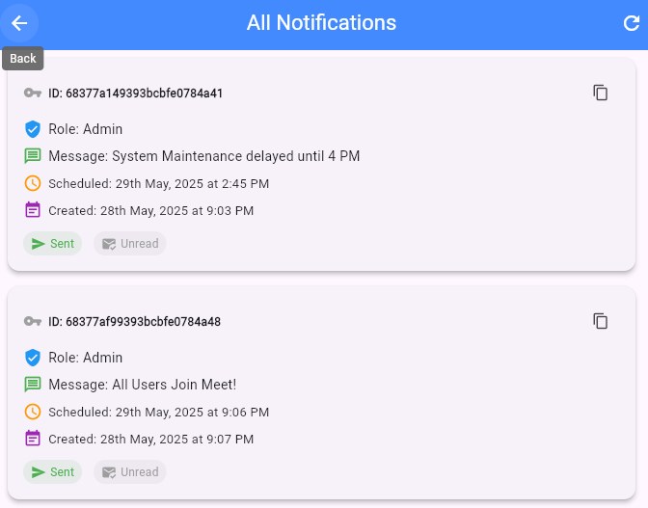
PREGNANT WOMAN

Slide 19
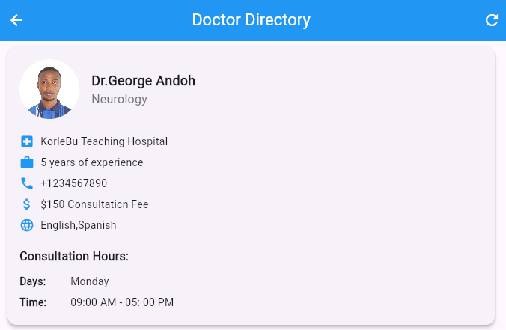
PREGNANT WOMAN

Slide 20
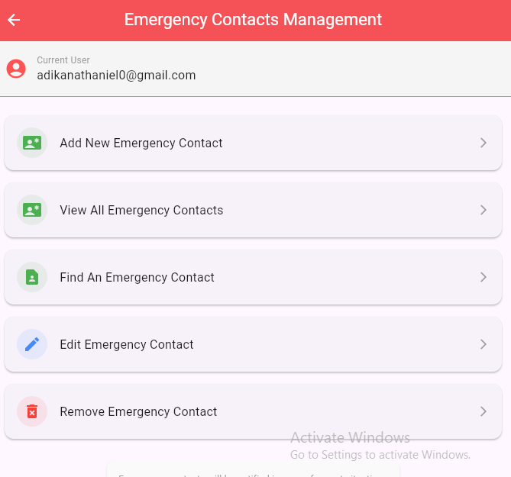
PREGNANT WOMAN

Slide 21
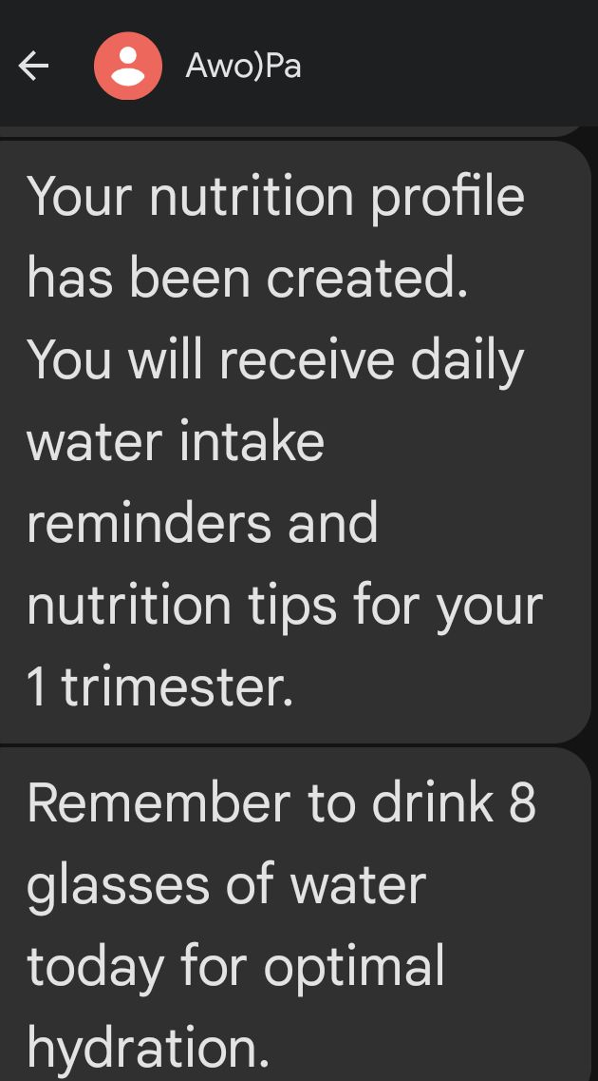
PREGNANT WOMAN

Slide 22
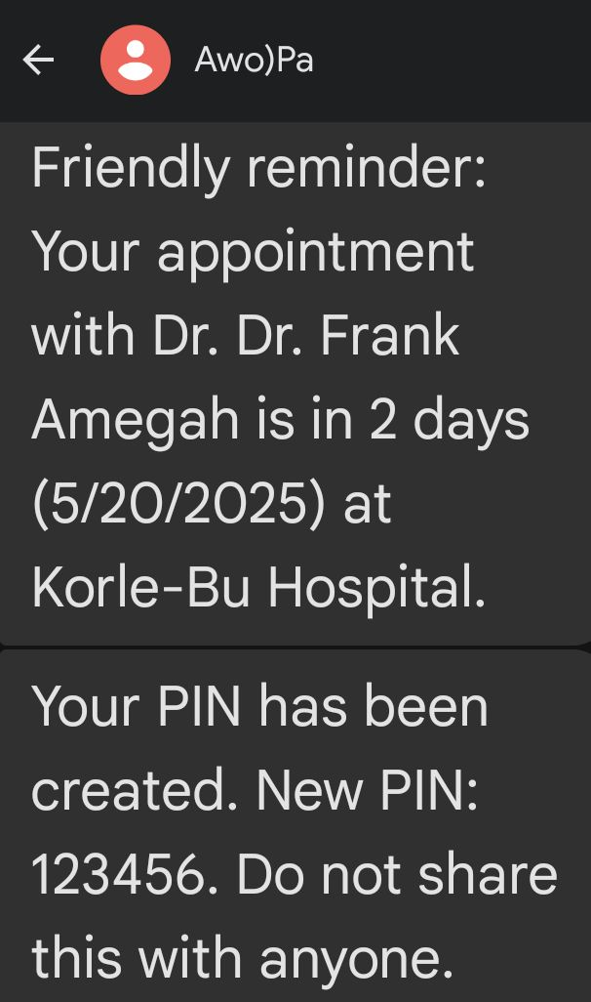
PREGNANT WOMAN

Slide 23
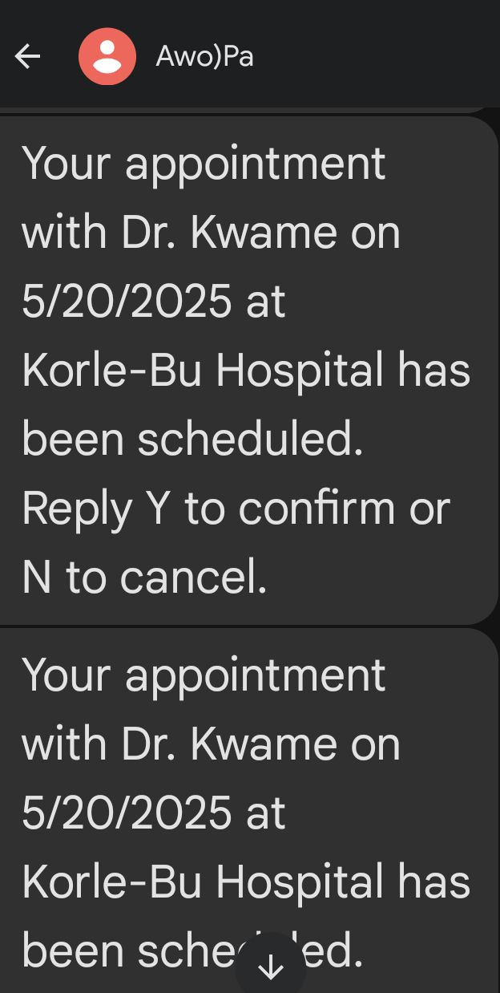
PREGNANT WOMAN

Slide 24
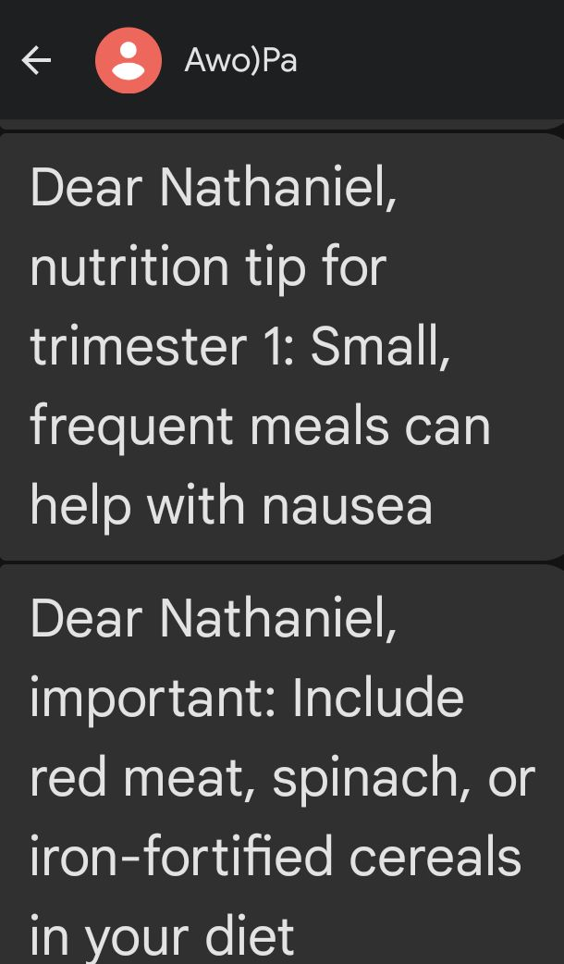
PREGNANT WOMAN

Slide 25
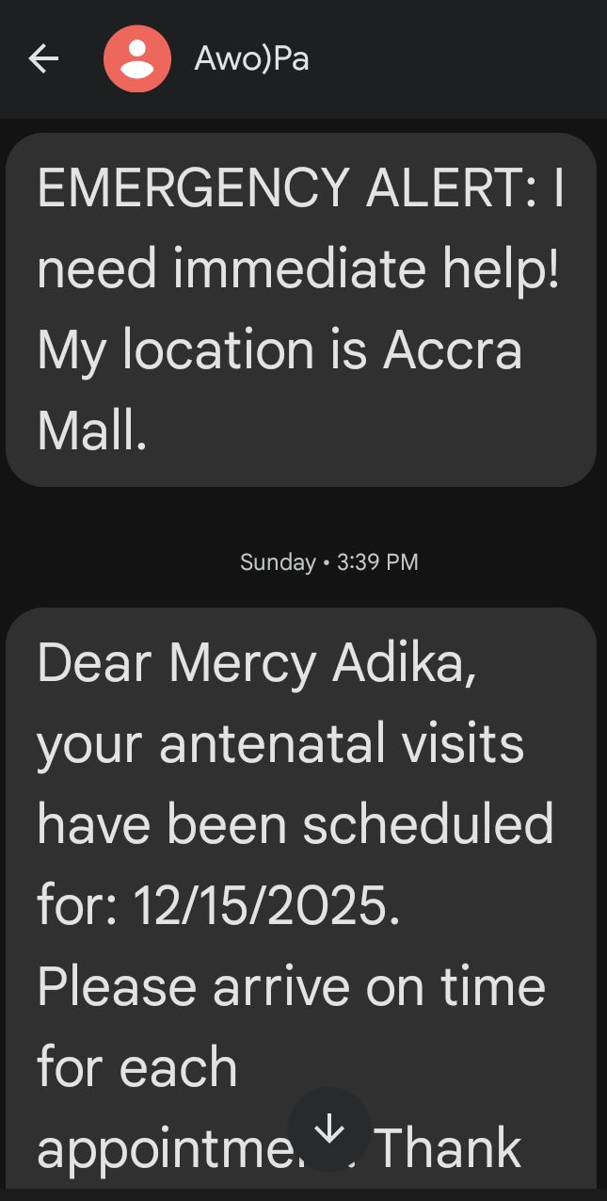
PREGNANT WOMAN

Slide 26
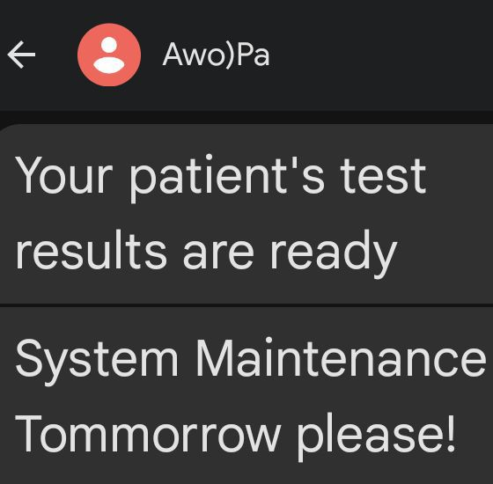
PREGNANT WOMAN

Slide 27
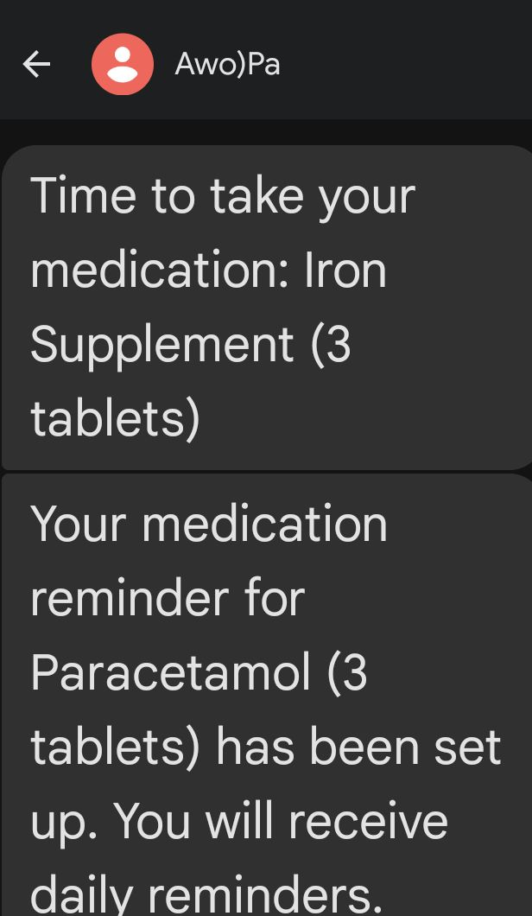
PREGNANT WOMAN

Slide 28
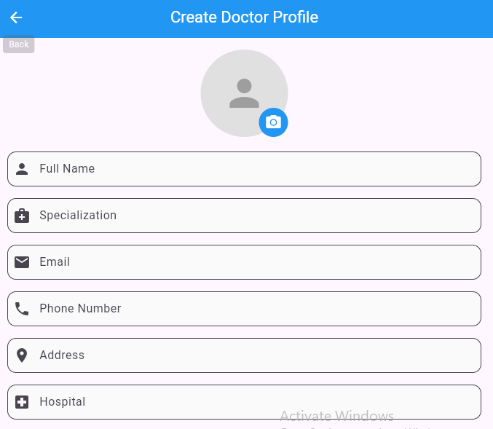
MEDICS

Slide 29
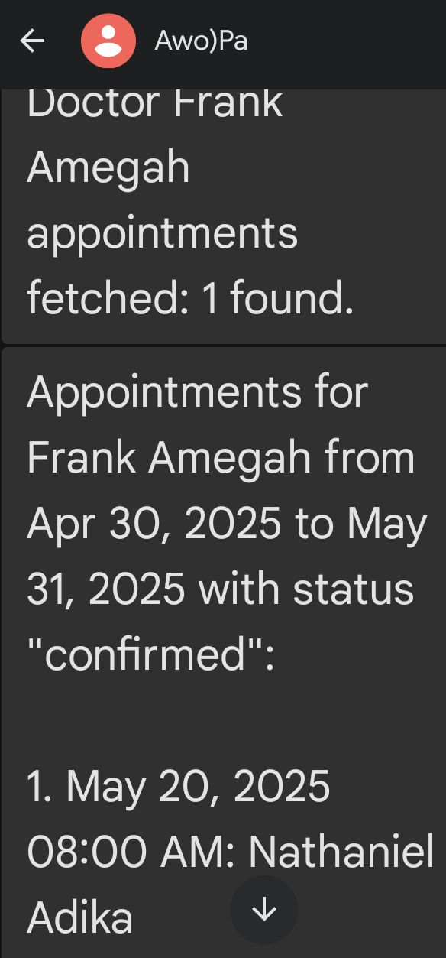
MEDICS

Slide 30
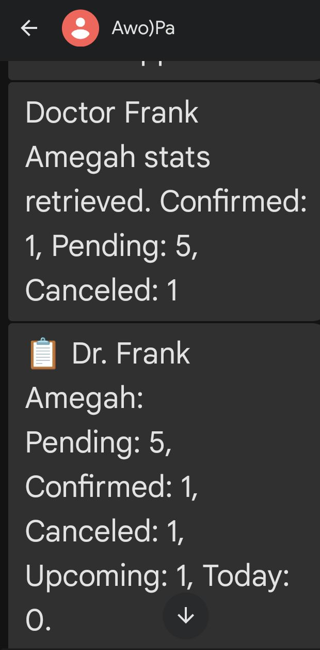
MEDICS

Slide 31
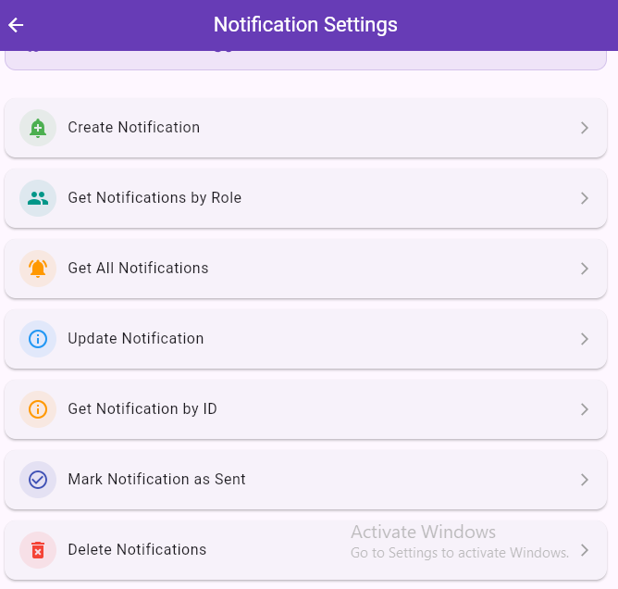
ADMIN

Slide 32
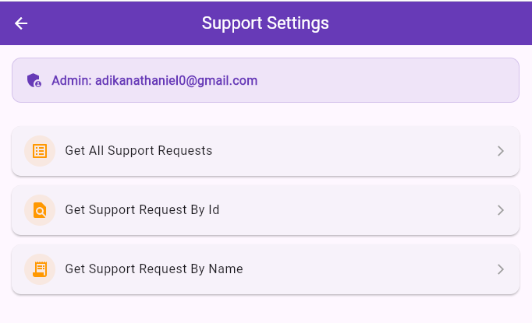
ADMIN

Slide 33
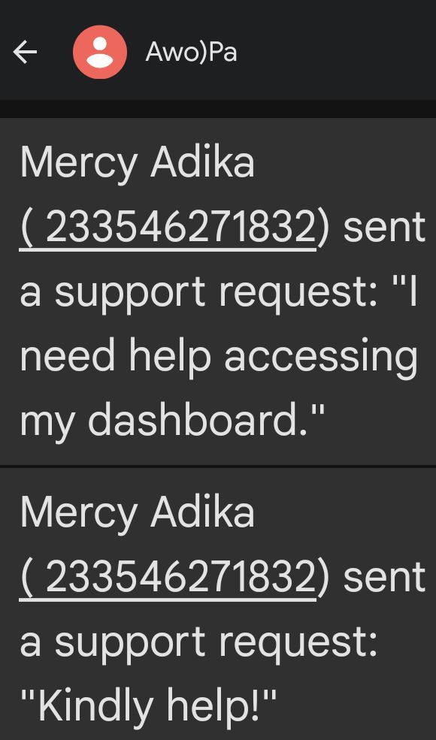
ADMIN

Slide 34
MISCELLANEOUS
QUESTIONS/FEEDBACK

